Slide 1
Parallel Approaches to the Travelling Salesman Problem
Ayushi Yadav
Daniyal Parveez Koustav Mallick

Slide 2
Agenda
Understanding the Problem Statement
Various Algorithms implemented
Results & Performance Evaluation
Conclusion

Slide 3

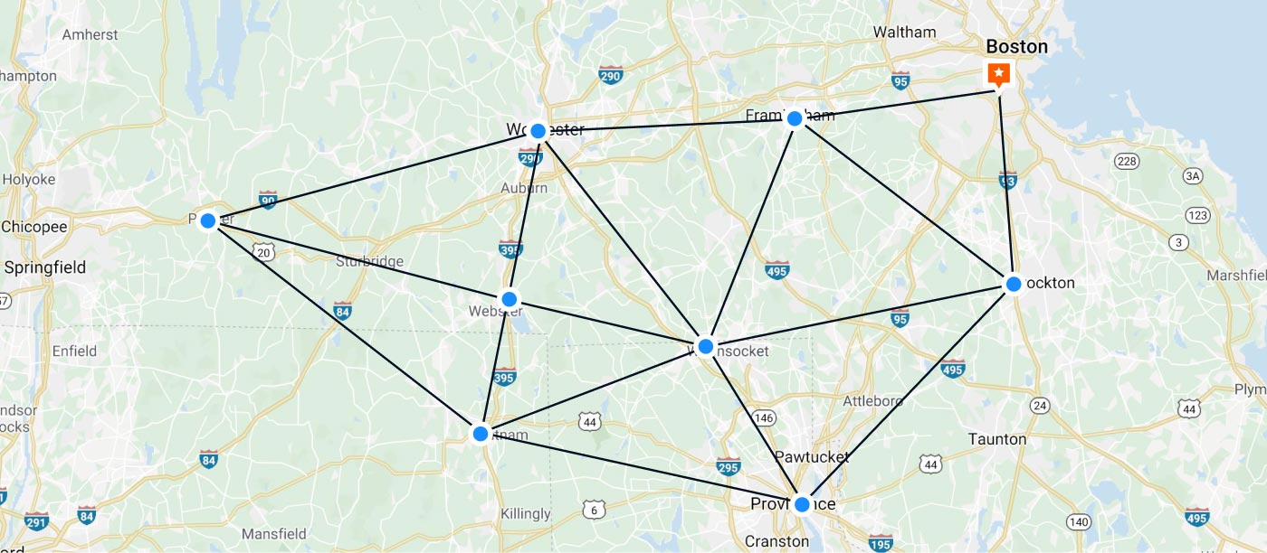
Understanding the Problem Statement
Classic optimization problem aiming to find the shortest route visiting each city exactly once before returning to the starting city, with the objective of minimizing total travel distance.
Classified as an NP-hard problem, meaning there is no known polynomial-time algorithm to solve it optimally for all instances.
Being able to solve TSP for large values of N in feasible time would have major implications for multiple fields.

Slide 4
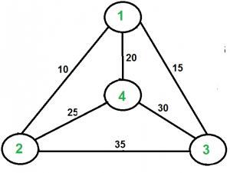
Example
Assuming starting city is 1,
Various paths possible: 1 - 2 - 3 - 4 - 1, 1 - 2 - 4 - 3- 1, etc.
Optimal path: 1 - 2 - 4 - 3 - 1, Cost = 10 + 25 + 30 + 15 = 80

Slide 5
Various algorithms implemented
Brute-Force (OMP)
Bellman-Held-Karp Algorithm
CUDA-based Genetic Algorithm

Slide 6
Brute-Force Approach (Serial)
Trivial to implement.
With the first and last city in the path fixed with the starting point, try all possible permutations for the remaining cities to visit.
Compute the cost for each path generated. Retain the path with lowest cost.
Computationally expensive – (n-1)! permutations possible.
Not feasible for non-trivial values of N.
Execution time is 1700 seconds for N=15, and increases steeply with increase in N.

Slide 7
Brute-Force Approach (Parallel)
Attempted to parallelize with OMP.
When generating permutations for N - 1 cities, one starts by fixing the leftmost value in permutation, only changing it after they have gone through all possible permutations with that fixture.
E.g.: N = 4, START = 0
Initial Path: 0 _ _ _ 0
Paths possible fixing 1 in first blank: <0, 1, 2, 3, 0>, <0, 1, 3, 2, 0>
Paths possible fixing 2 in first blank: <0, 2, 1, 3, 0>, <0, 2, 3, 1, 0>
Paths possible fixing 3 in first blank: <0, 3, 1, 2, 0>, <0, 3, 2, 1, 0>
There are N-1 instances for selecting the 1st city to visit.

Slide 8
Brute-Force Approach (Parallel)
We can exploit this idea for easy parallelization.
Have a loop for N-1 iterations, where each iteration deals with a unique 1st city between 0 and N-1 (starting city excluded).
Can parallelize this for loop.
Makes sense to have upto N-1 threads.
Noticeable improvement BUT limit of number of iterations limits scalability.

Slide 9
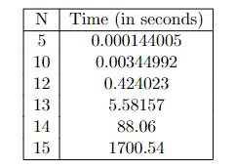
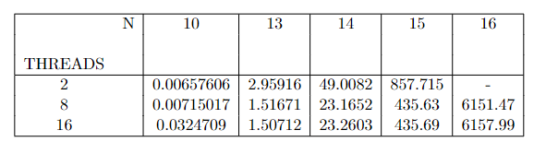
Brute-Force Approach - Execution Results
Table: Serial Execution
Table: Parallel Execution

Slide 10
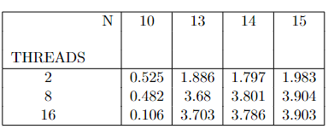
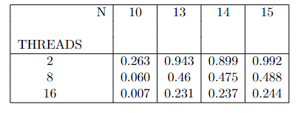
Brute-Force Approach - Metrics
Table: Speedup Comparison
Table: Efficiency Comparison

Slide 11
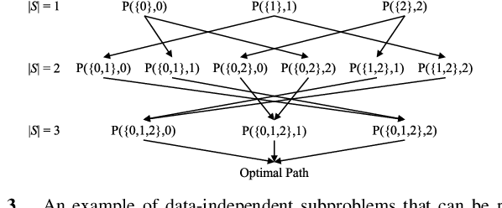
Bellman-Held-Karp (Serial)
Breaks TSP down as a multistage decision problem using dynamic programming.
Time complexity is O(n^2 . 2^n) due to the nested loops over cities and subsets of cities.

Slide 12
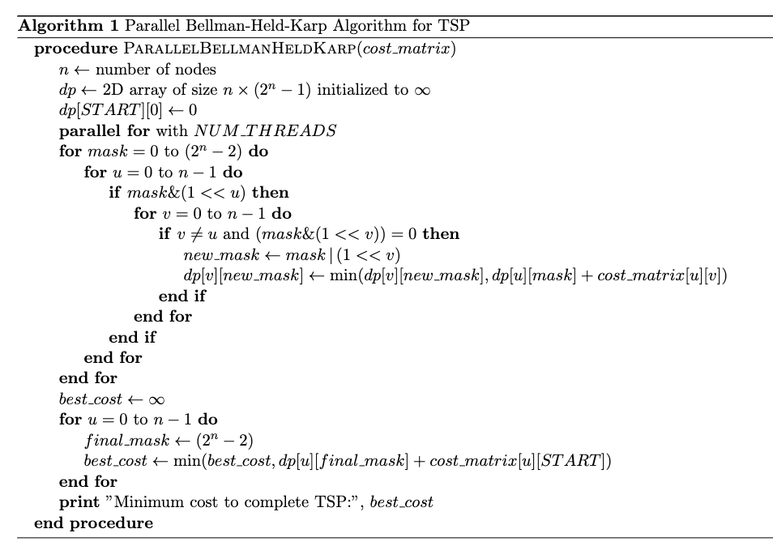
Bellman-Held-Karp (Parallel)

Slide 13
Bellman-Held-Karp (Parallel)
TSP parallel is achieved using Python’s Numba package, by utilising the JIT Compiler.
Held-Karp algorithm worked fine until 20 cities.
Due to memoization of previously visited cities, major part of the implementation doesn’t take advantage of parallelization.
Scalability is a challenge in this case.

Slide 14
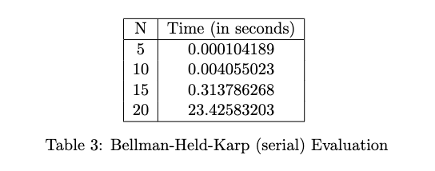
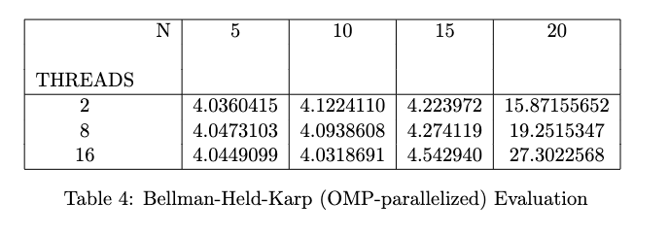
Bellman Held Karp - Execution Results

Slide 15
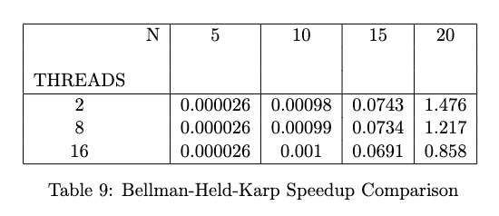
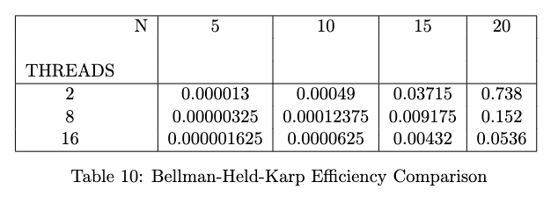
Bellman Held Karp - Metrics

Slide 16
Genetic Algorithm (Serial)
Heuristic based Approach to generate approximate result for NP Hard Problem.
This approach generates the best possible solution by approximating the fitness of evaluation features against required criteria.
For TSP, we went for selecting the inverse of distance as the benchmark feature for fitness, and repeated the same for multiple generations. Then gathered the highest fitness (lowest distance) result.

Slide 17
Genetic Algorithm (Parallel)
The evaluation of fitness in every iteration is parallelised here, using CUDA.
Each thread calculates computes the fitness for one tour independently of others, allowing concurrent execution for different tours in population.
We have taken total number of blocks as the total number of population (permutation of all possible city nodes) divided by threads, allowing us achieve data segmentation.
Due to nature of this algorithm, we could evaluate with higher number of cities for this algorithm, compared to the others.

Slide 18
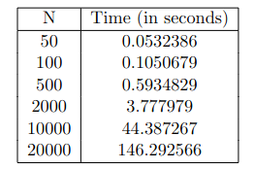
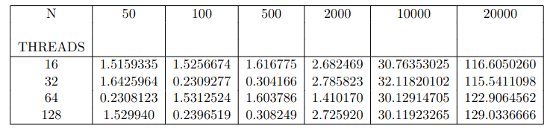
Genetic Algorithm- Execution Results
Table: Serial Execution
Table: Parallel Execution

Slide 19
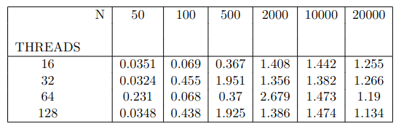
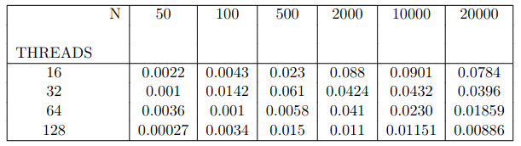
Genetic Algorithm - Metrics
Table: Speedup Comparison
Table: Efficiency Comparison

Slide 20
Conclusion
Bellman-Held-Karp, although serially less computationally exhaustive than brute-force, can not be parallelized efficiently.
Scalability is an issue with BHK and Brute-Force Algorithms.
Genetic Algorithm is more efficient than BHK and less efficient than Brute-Force approach for lower scale inputs.
Although Genetic Algorithm doesn’t provide exact solution, this solution is scalable and more efficient in higher scales. This approach can be adapted in large scale scenarios where approximation is accepted.

Slide 21
Fin.

